Slide 1
DAA PROJECT IMPLEMENTION
Module-:Program Level Ojective Setting
Submitted By : Team TECH TITANS
S.Revanth Sai - AP23110011112
T. Amruthaa - AP23110011142
K.Praneeth chandra - AP23110011166
K.Mokshagna - AP23110011110
K.Kiranmai - AP23110010716
SB.Navaneeth - AP23110011106
BTECH|CSE-P|SEMESTER-3|2023-27

Slide 2
Introduction to Project
The Course Objective Setting Module is an essential component of Outcome-Based Education (OBE). This module ensures that the course objectives are clearly defined, measurable, and aligned with the overall program goals. By establishing specific course objectives that are aligned with program-level outcomes, this module helps create a structured framework for ensuring that each course contributes effectively to the achievement of the program’s educational goals. This alignment forms the foundation for assessment strategies, curriculum design, and the continuous improvement process.

Slide 3
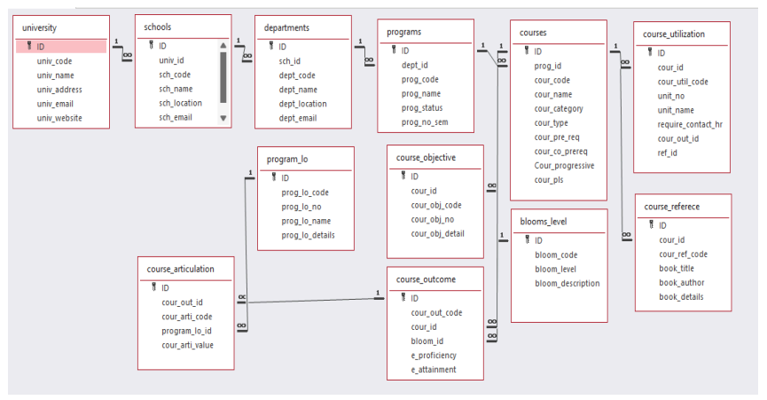

Architecture Diagram

Slide 4
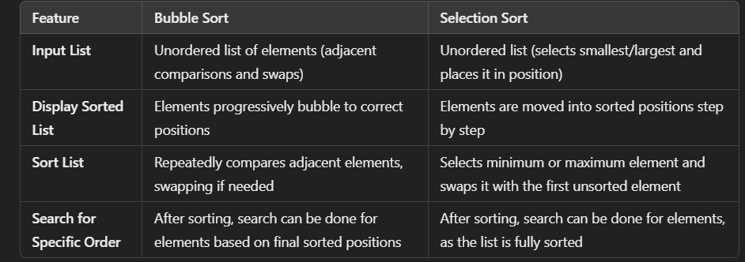
Module Description : Program Level Objective Setting
Module Description:
This module focuses on defining and structuring course objectives that are aligned with program-level goals. It provides a systematic approach for mapping these objectives to the broader program outcomes. By doing so, the module supports curriculum coherence and facilitates continuous improvement.
.

Slide 5
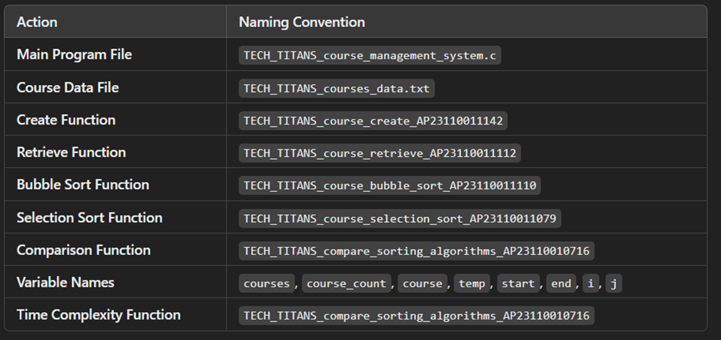
Field/table details: For Programs

Slide 6
Sorting Algorithm used
Start
Input matrix of size courses x outcomes
For i = 0 to courses - 1:
For j = i + 1 to courses:
Initialize sum_i = 0 and sum_j = 0
For k = 0 to outcomes - 1:
sum_i += matrix[i][k]
sum_j += matrix[j][k]
If sum_i > sum_j:
For k = 0 to outcomes - 1:
Swap matrix[i][k] and matrix[j][k]
Output sorted matrix
End

Slide 7
Sorting Algorithm used
Selection Sort :
Algorithm:
Step-1: Ask user to choose a field to sort by (code or name).
Step-2:loop from 0 to program_count-1
Step-3: set min_index = I
Step -4:loop from i+1 to program_count
Step-5: if programs[j]<program[j+1] then replace the values of min_index to j
Step-6: swap prorams[i] = programs[min_index]
Step-7: continue the program until complete array to be sorted
Step-8: print success message

Slide 8
Time Complexity of Sorting Algorithm
Sl.No | Algorithm Name | Complexity of Algorithm
01 | Bubble Sort | O(n^2)
02 | Selection Sort | O(n^2)

Slide 9
SORTED MATRIX ALGORITHM :
Start
Input matrix of size courses x outcomes
For i = 0 to courses - 1:
For j = i + 1 to courses:
Initialize sum_i = 0 and sum_j = 0
For k = 0 to outcomes - 1:
sum_i += matrix[i][k]
sum_j += matrix[j][k]
If sum_i > sum_j:
For k = 0 to outcomes - 1:
Swap matrix[i][k] and matrix[j][k]
Output sorted matrix
End

Slide 10
ALGORITHM FOR COURSE OBJECTIVE SETTING:
1. Initialize objective list and objective_count = 0
2. Repeat:
a. Display menu (Set Objective, Display Objectives, Exit)
b. Input user choice
c. If choice = "Set Objective":
- Input objective description
- Input assessment method
- Input week number
- Check if objective is SMART
- Store objective in list
- Increment objective_count
d. If choice = "Display Objectives":
- For each objective in the list:
- Display objective description, assessment method, week, and SMART status
e. If choice = "Exit":
- End the program

Slide 11
Time Complexity of Searching Algorithm
Sl.No | Algorithm Name | Complexity of Algorithm
01 | Course articulation | O(k)
02 | Sorted matrix | O(kn^2)

Slide 12
Overview Code[overview of searching,Sorting,CRUD and Storage options]
// 1. CRUD Operations
void create_course_AP23110011142();
void retrieve_courses_AP23110011112();
void bubble_sort_courses_AP23110011110();
void selection_sort_courses_AP23110011079();
void compare_sorting_algorithms_AP23110010716();

Slide 13
// 2. Sorting (e.g., by sum of elements in rows) void sortMatrix(int matrix[MAX_COURSES][MAX_OUTCOMES], int courses, int outcomes) { // Sorts matrix rows based on the sum of their elements for (int i = 0; i < courses - 1; i++) { for (int j = i + 1; j < courses; j++) { int sum_i = 0, sum_j = 0; for (int k = 0; k < outcomes; k++) { sum_i += matrix[i][k]; sum_j += matrix[j][k]; } if (sum_i > sum_j) { for (int k = 0; k < outcomes; k++) { int temp = matrix[i][k]; matrix[i][k] = matrix[j][k]; matrix[j][k] = temp; } } } } }

Slide 14
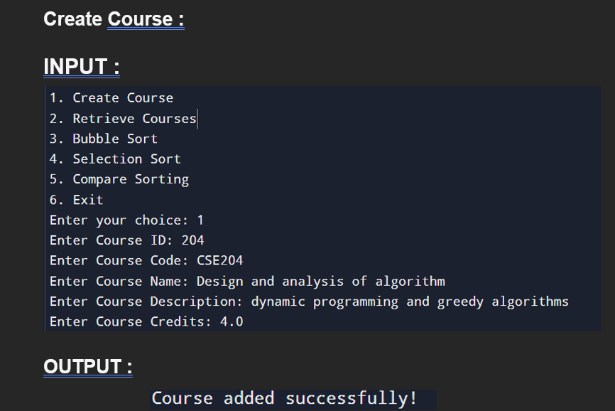
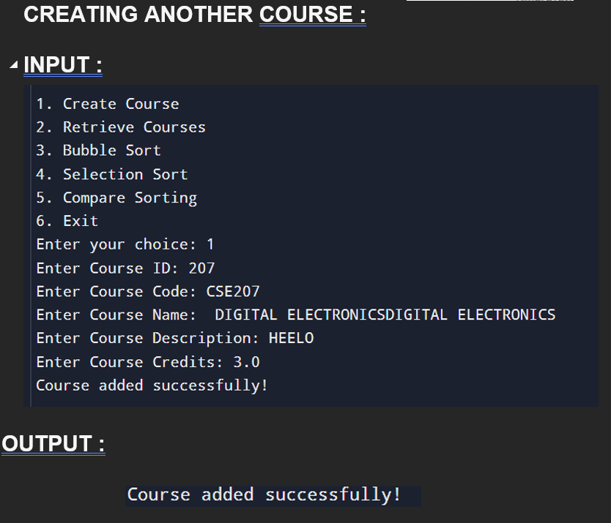
screenshots

Slide 15
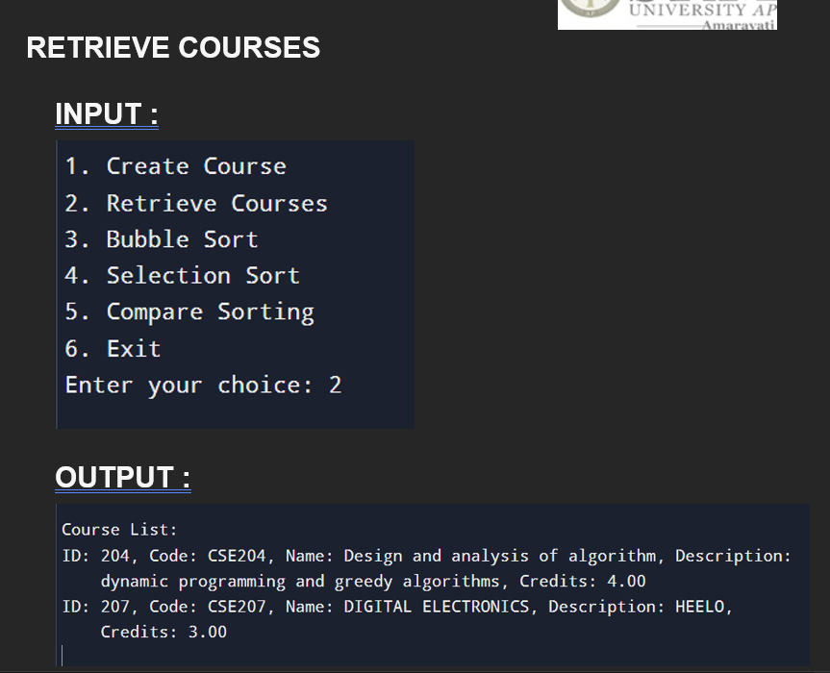
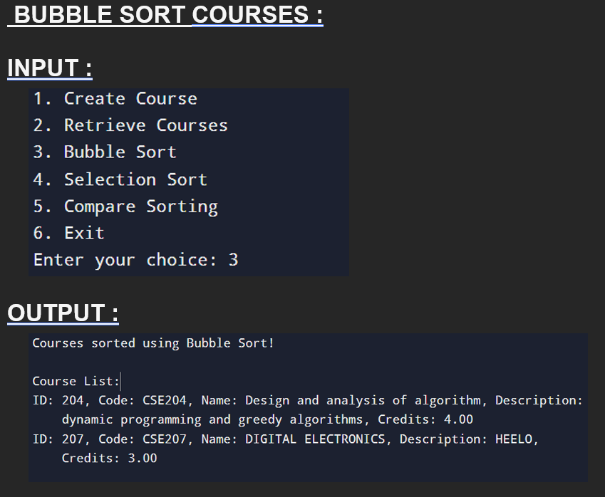

Slide 16
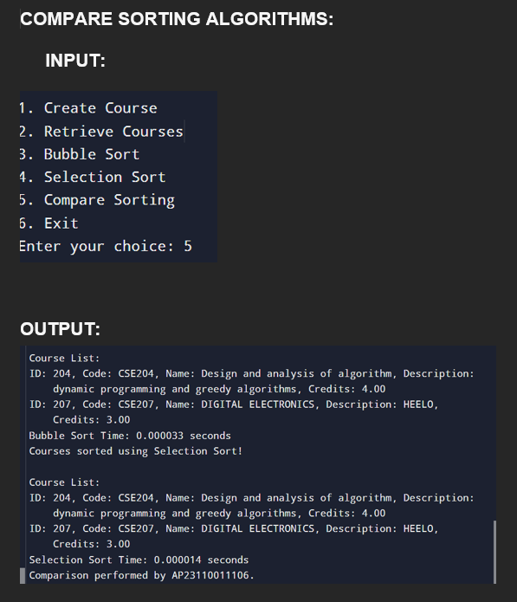
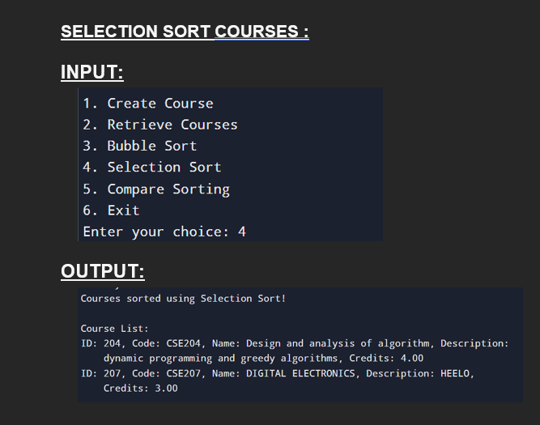

Slide 17
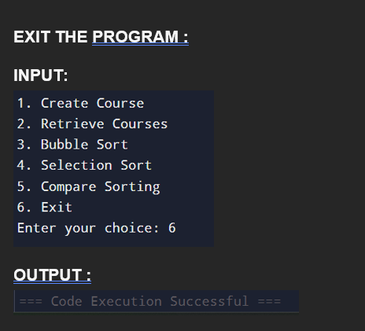

Slide 18
Conclusion
In the programming section, we designed a comprehensive C program that handles a Course Objective setting. This program includes functionalities for inputting details & displaying it, sorting the courses based on specific criteria, and searching for a particular course articulation. We provided detailed steps to capture screenshots and explained how to document the code with an architecture diagram.
By implementing these concepts, you gained valuable insights into practical programming, enhancing your problem-solving skills and ability to organize and present technical information effectively.

Slide 19


